Slide 1

Service Desk Interaction Analysis (text classification)

Slide 2
Agenda
problem statement
approach
technique used: text embedding
caveats of using real data
what we tried
final model / results

Slide 3
current situation
service desk
service desk
user
interaction
fulfillment
user
resolve
feedback
calls
creates
assigns
assigns
?
QM
problem
assigning a ticket to the correct group requires either…
lot of experience
research
and often leads to
new agents struggling and delays
>600 groups

Slide 4
current situation
service desk
service desk
user
interaction
fulfillment
user
resolve
feedback
calls
creates
assigns
assigns
?
QM
problem
assigning a ticket to the correct group requires either…
lot of experience
research
and often leads to
new agents struggling and delays
>600 groups

Slide 5
current situation
service desk
service desk
user
interaction
fulfillment
user
resolve
feedback
calls
creates
assigns
assigns
?
QM
problem
assigning a ticket to the correct group requires either…
lot of experience
research
and often leads to
new agents struggling and delays
>600 groups

Slide 6
idea
service desk
service desk
user
interaction
fulfillment
user
resolve
feedback
calls
creates
assigns
predicts
solution
replace QM by a NN trained on
interactions of past 4 years (>800k tickets) description and
incidents of past 4 years (>100k tickets) description
in order to
predict the correct assignment group / class
>600 groups

Slide 7
approach
Research techniques
Apply on “exemplary data“
Convert model to real data
Train on real data
1
2
3
4

Slide 8
text classification: bow & word embedding
Bag of Words (BOW)
Just a list of words and counts (e.g. term frequency, TF-IDF, n-grams)
Too simplistic, looses a lot of semantic information (structure, sequence, etc.)
Better: Word Embedding
Words/Documents represented in vector space model
Words close in meaning are close to each other in vector space
Tries to capture the semantic relationships between words

Slide 9

text classification: pre-trained vectors
Pre-trained datasets available:
Stanford: GloVe (Global Vectors for Word Representation)
Google: Word2Vec
Facebook OS: fastText
GloVe:
6 billion tokens, 400k vocabulary
In order to capture in a quantitative way the nuance necessary to distinguish man from woman, it is necessary for a model to associate more than a single number to the word pair. A natural and simple candidate for an enlarged set of discriminative numbers is the vector difference between the two word vectors.

Slide 10
using pre-trained vectors in practice classifying newsgroups messages into 6 classes
load
pre-process
embedding matrix
define model
fit

Slide 11
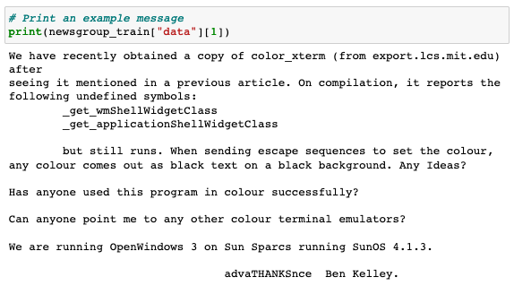
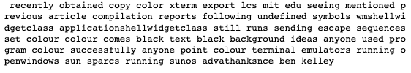
using pre-trained vectors in practice classifying newsgroups messages into 6 classes
load
pre-process
embedding matrix
define model
fit

Slide 12
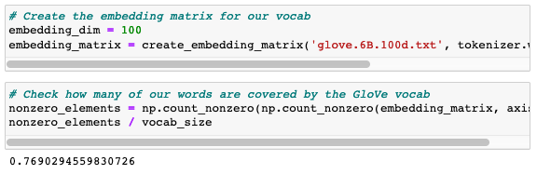
using pre-trained vectors in practice classifying newsgroups messages into 6 classes
load
pre-process
embedding matrix
define model
fit

Slide 13
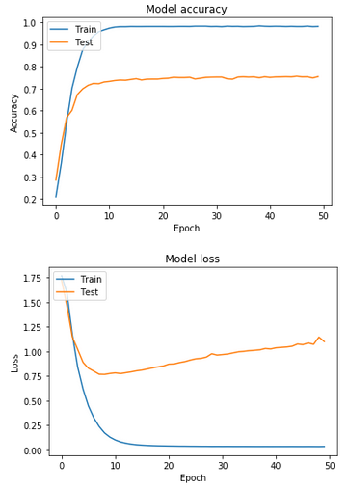
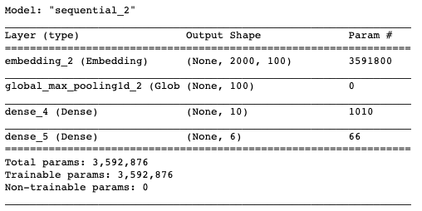
using pre-trained vectors in practice classifying newsgroups messages into 6 classes
load
pre-process
embedding matrix
define model
fit
Best case: 75% accuracy

Slide 14
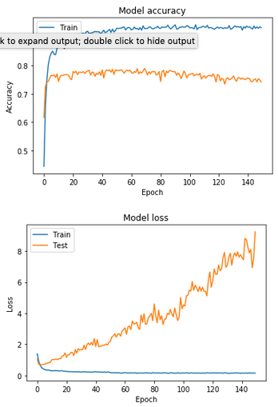
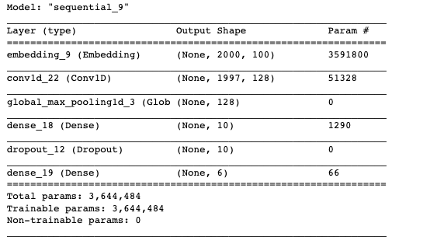
using pre-trained vectors in practice classifying newsgroups messages into 6 classes
Best case: 78% accuracy

Slide 15
approach
Research techniques
Apply on “exemplary data“
Convert model to real data
Train on real data
1
2
3
4

Slide 16


challenges when using real data 1/2
working with “exemplary data”
working with real data
pd.read_csv(file, delimiter = “;“)

Slide 17
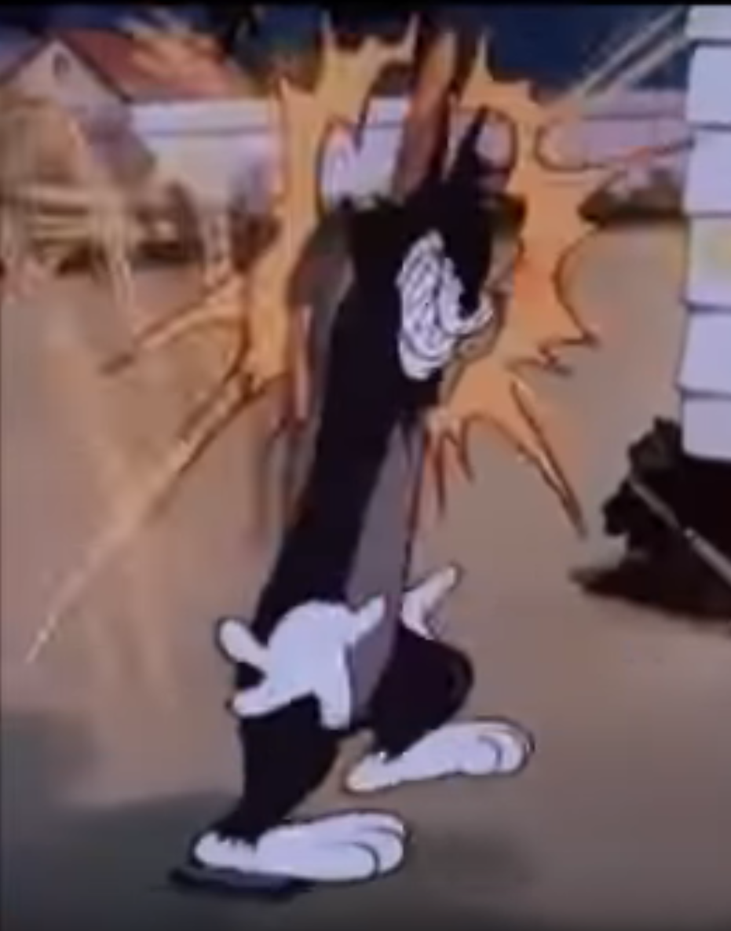


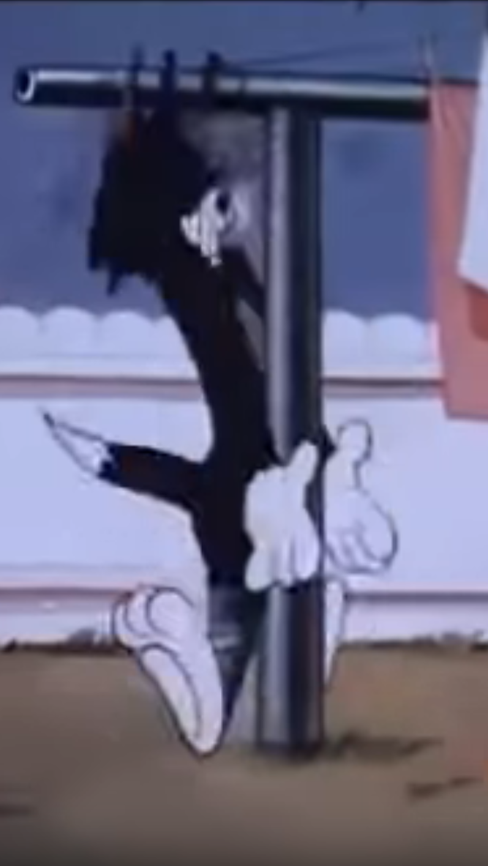
Challenges when using real data 2/2
special characters
no spaces
different languages
buckets

Slide 18


transition to corporate network
installing things at home
installation in corporate network
OS
security

Slide 19
approach
Research techniques
Apply on “exemplary data“
Convert model to real data
Train on real data
1
2
3
4

Slide 20
What we tried
cleansing the data: regex, removing stopwords, removing tickets in other languages, removing bucket classes, stemming, removing common words…
different ways to vectorize the ticket data (different approaches of bag of words, embedding…)
different size of vocabulary
play around with embedding dimensions
adding/removing dense layers and adjusting their size
adding maxpooling layers
dropout
different activation functions
…
in general what brought us big gains in accuracy:
word embedding / maxpooling
dropout

Slide 21

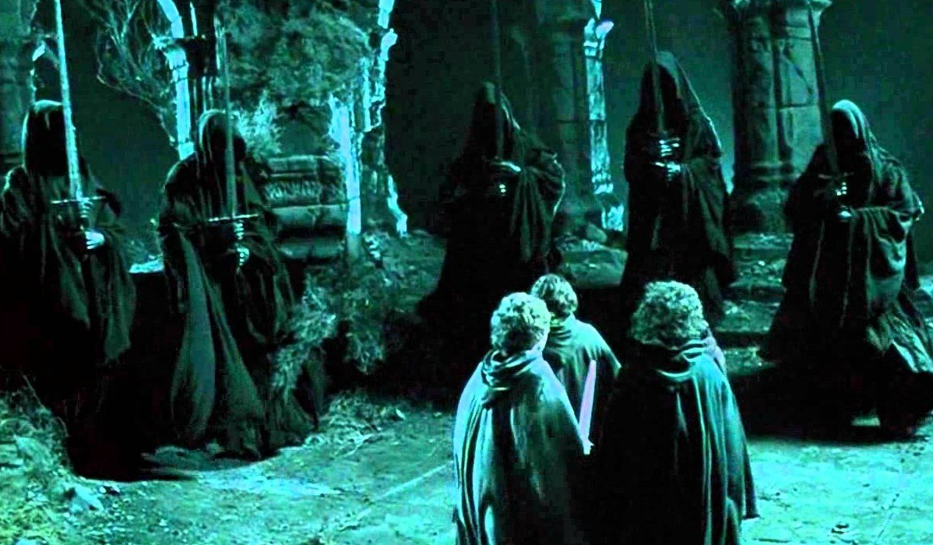







What kept us from trying more
e.g. adjusting parameters even more, CNNs, RNNs…
training network at home
sudo
training network at work

Slide 22
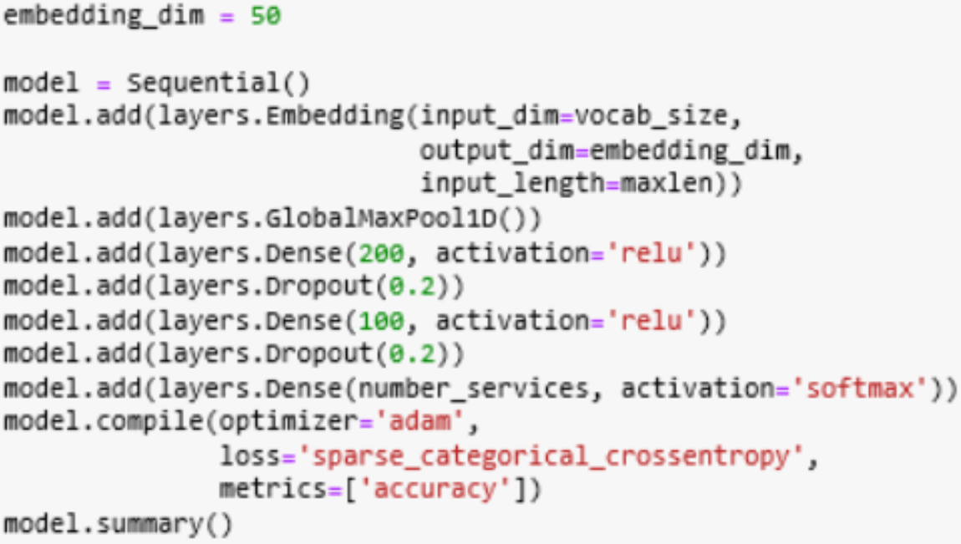
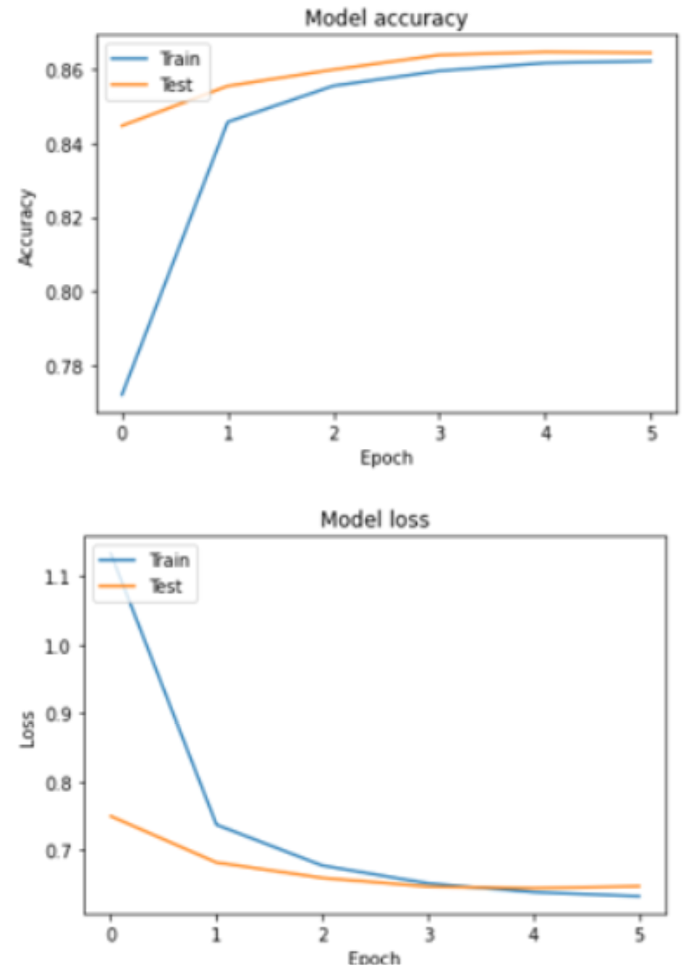
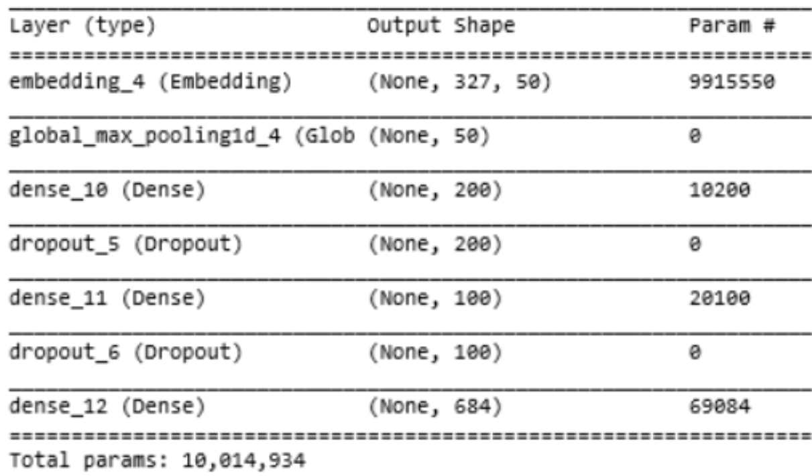
Results
model that gave us best results
KPIs
~86% accuracy on test data
~86% accuracy on training data
1 epoche took about 8000s
after around 6 epochs loss went up again for test data
around ~500 classes

Slide 23
Questions?

